Slide 1
IRWCConference

Slide 2
Software and addiction - the Human Element
The Potential and
Obstacles in Distance Coaching for Addictions
Bob Griffiths
CoachMaster

Slide 3
Bob
Griffiths
25 years coaching experience
Not an addiction expert!
Author of “Grow your own Carrot”
– the definitive guide to the GROW process
Trained in brief therapy, gestalt psychology, inner game theory and NLP
Developer of CoachMaster™ software. See video
Some Layouts have both Animated & Static.
Delete pages you don’t need and keep others. Click on items to and move them around if you want. Pretty much everything is customizable.

Slide 4
The Presentation
An opportunity for discussion
No quick answers
Looking at one partial solution – there will be others
An opportunity for ongoing dialogue

Slide 5
What are we facing?
Substance
Addictions
Food
Drugs
Alcohol
Prescription Drugs
Some Layouts have both Animated & Static.
Delete pages you don’t need and keep others. Click on items to and move them around if you want. Pretty much everything is customizable.

Slide 6
What are we facing?
Behavior
Addictions
Gambling
Food
Sex
The Internet
Work
Some Layouts have both Animated & Static.
Delete pages you don’t need and keep others. Click on items to and move them around if you want. Pretty much everything is customizable.

Slide 7
Why should I stop?
Addictions can feel good
Seem to handle some kind of problem
It does not seem to be causing any problems now
Fear of what happens if I stop
We can rationalise our behaviour

Slide 8
Obstacles to controlling addiction
Symptoms sometimes develop slowly
Commercial
Pressures
Genetic
Predisposition
Lack of
Resources
Lack of
Awareness
Multiple causes
Socioeconomic / Physical /
Mental Health
Little value put on
Prevention

Slide 9
Could Coaching Help?
Not a panacea
Benefits from a live human being on the other end
Based on two people concentrating on one person’s problem
There are established and proven methodologies for addictions
like Motivational Interviewing and CBT which use a form of
coaching
Some Layouts have both Animated & Static.
Delete pages you don’t need and keep others. Click on items to and move them around if you want. Pretty much everything is customizable.

Slide 10
Obstacles to applying Coaching
Not enough skilled coaches
Recovery coaching often requires a long term, intense relationship
Too
costly
Lack of awareness
of help available
Difficult to get
Funding
Effective coach training takes
a long time
Coaches are not in the right
location
Social rules against
asking for help

Slide 11
Could we create Scalable, Effective Coaching Conversations through Technology?
Change the Color
of any of the icons by right-clicking on any of them (be sure you have the image or section of the image you want, sometimes Powerpoint can be a little tricky at selecting things) then choosing fill and picking your color. NOTE: As you can see some of the graphics have multiple pieces to color. Be sure to double click a few times on the individual parts to select them in order to color correctly.

Slide 12
How to scale Addiction Coaching
Leverage expert knowledge and make it available to others
Train cohorts of individuals in interpersonal skills – barefoot coaches
Build a communities where coaches and clients could get advice and support.
Build in ratings so effective coaches build up a positive reputation
Use established coaches to train others and ‘cascade’ skills downwards
Support coaches with regular supervision
Find ways of publicizing that help is available.
Pu
Some Layouts have both Animated & Static.
Delete pages you don’t need and keep others. Click on items to and move them around if you want. Pretty much everything is customizable.

Slide 13
What is CoachMaster™ Software?
A program which provides ‘templates’ for coaching conversations
A means of recording sessions and agreements
Operates like the GPS in a car
Can be used both for training and actual sessions

Slide 14
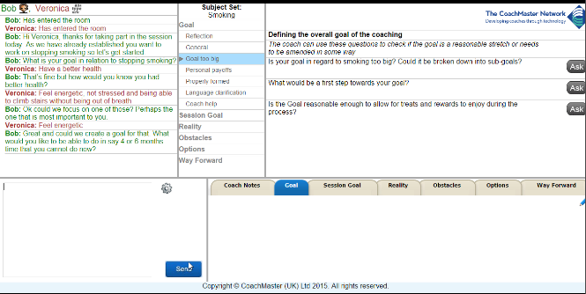
CoachMaster™ software Coaches View
Preserves a full record of coaching sessions for training and supervision.
A library of consistent and professional coaching processes is available. Each designed for a specific client issue.
Extensive information on good coaching
practise built into every stage
Change the Color
of any of the icons by right-clicking on any of them (be sure you have the image or section of the image you want, sometimes Powerpoint can be a little tricky at selecting things) then choosing fill and picking your color. NOTE: As you can see some of the graphics have multiple pieces to color. Be sure to double click a few times on the individual parts to select them in order to color correctly.
Accountability built in. Action points are automatically emailed to coach and client(s).
Summary Tabs for each stage which are shared with the client(s)

Slide 15
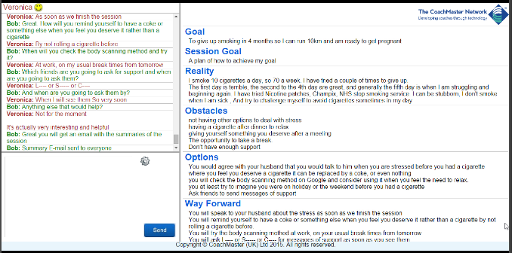
CoachMaster™ software
Client’s View
Summary for each stage recorded on the system
Change the Color
of any of the icons by right-clicking on any of them (be sure you have the image or section of the image you want, sometimes Powerpoint can be a little tricky at selecting things) then choosing fill and picking your color. NOTE: As you can see some of the graphics have multiple pieces to color. Be sure to double click a few times on the individual parts to select them in order to color correctly.
Full record of coaching sessions kept for training and supervision.
Notes:
Looks good – would also add an extra slide showing the ‘employee’ view

Slide 16
How CoachMaster could contribute
As a Training Tool
Students work on real addiction coaching scenarios
Scenarios can be developed for different addiction situations
Scenarios can be for any level of complexity
Provides evidence of competency
Allows targeted feedback
For Real Time Coaching
Question sets available for a huge range of addiction situations
Each question set has built in coach information for likely issues
Faster coach development through focused supervision
Provides evidence of timing and duration of sessions
Some Layouts have both Animated & Static.
Delete pages you don’t need and keep others. Click on items to and move them around if you want. Pretty much everything is customizable.

Slide 17
Distance addiction coaching
Gives the coach a framework for addiction coaching discussions
There can be any number of frameworks according to type of addiction, severity, age of client, education level, location or any other variable
Probably more suitable for addictions like smoking, weight loss, gambling and individuals who are functioning at a reasonable level
Can be adapted to include different theories about addiction
Coach and client can connect using text, voice and video or a combination
Client just needs a telephone, although an Internet connection is desirable
Encourages reflection and learning for coach and client
Coach can record the discussion and automatically send a summary to the client
Can create a strong sense of connection if used with presence and skill.
Some Layouts have both Animated & Static.
Delete pages you don’t need and keep others. Click on items to and move them around if you want. Pretty much everything is customizable.

Slide 18
Discussion:
What could be the potential of this approach
to addiction coaching?
What could be the obstacles?
Some Layouts have both Animated & Static.
Delete pages you don’t need and keep others. Click on items to and move them around if you want. Pretty much everything is customizable.

Slide 19
Stay in touch
Get involved
Share ideas
7 Dovedale Studios, 465 Battersea Park Rd, London, SW11 4LR
info@coachmaster.co.uk
Tel +44 207 787 8599 M: +44 7931 851033
CoachMaster™
Some Layouts have both Animated & Static.
Delete pages you don’t need and keep others. Click on items to and move them around if you want. Pretty much everything is customizable.

